Slide 1
QUESTIONNAIRE DESIGN

Slide 2
BASIC CONSIDERATIONS IN QUESTIONNAIRE DESIGN
A researcher who is systematically planning a questionnaire’s design will be required to make several decisions as following
What should be asked? (Relevant to the objective)
What type of scale is needed to perform the desired analysis to answer the management question? (measurement of the response)
What communication approach will be used? (depending on communication approach the question will be slightly modified)
Should the question be structured, or unstructured? (exploratory and causal)
Should the question be disguised/undisguised? ( if the content can lead to bias)
How should questions be phrased? (wording)
In what sequence should the questions be arranged?
What questionnaire layout will best serve the research objectives?
How should the questionnaire be pretested? Does the questionnaire need to be revised?

Slide 3
WHAT SHOULD BE ASKED?
Some thing which is having relevancy and accuracy with the objective
If the task is to pinpoint store image problems, questions asking for political opinions are highly irrelevant. (store convenience)
Irrelevant questions are more than a nuisance because they make the survey needlessly long.
Conversely, many researchers, after conducting surveys, find that they omitted some important questions. Therefore, when planning the questionnaire design, researchers must think about possible omissions.

Slide 4
WHAT TYPE OF SCALE IS NEEDED TO PERFORM THE DESIRED ANALYSIS TO ANSWER THE MANAGEMENT QUESTION?
Covered in measurement and scaling class

Slide 5
WHAT COMMUNICATION APPROACH WILL BE USED?
The means of data collection—telephone interview, personal interview, self-administered questionnaire—will influence the question format and question phrasing.
In general, questions for mail, Internet, and telephone surveys must be less complex than those used in personal interviews.

Slide 7
Responses are to be expected based on the question medium.
Do you give financial support to charitable causes on a regular basis?
People who are asked these questions on the telephone give responses that are more protective of their image than do people asked the very same questions via a typical Internet-type questionnaire.
Phone survey results suggest a 10 percent difference in the response to the charitable giving question with phone respondents displaying a greater inclination to give to charities than people answering the question via the electronic questionnaire.
Do you go to church on a regular basis?
On the phone, almost 6 in 10 respondents report going to church almost weekly but via the computer, that number drops to 1 in 4.
This is not questionnaire design but more of method of administering the questionnaire

Slide 8
SHOULD THE QUESTION BE STRUCTURED, UNSTRUCTURED, OR SOME COMBINATION?
One of the decision in questionnaire design is based on the amount of freedom respondents have in answering.
Should the question be open-ended (unstructured), allowing the participants freedom to choose their manner of response, or closed (structured), where the participants choose their response from an already determined fixed set of choices?

Slide 9
Examples of open ended questions
What names of local banks can you think of offhand?
What comes to mind when you look at this advertisement?
In what way could this product be changed or improved? I’d like you to tell me anything you can think of, no matter how minor it seems.
What things do you like most about Federal Express’s service?
Why do you buy more of your clothing in Nordstrom than in other stores?
How can our stores better serve your needs?
Please tell me anything at all that you remember about the BMW commercial you saw last night.

Slide 10
Example of Fixed- alternative question/closed questions/structured

Slide 11
Open-ended response questions are most beneficial when the researcher is conducting exploratory research, especially when the range of responses is not known.
Also, open-ended response questions are valuable at the beginning of an interview. They are good first questions because they allow respondents to warm up to the questioning process.

Slide 12
Types of Fixed-Alternative Questions
The simple-dichotomy (dichotomous-alternative) question
The simple-dichotomy (dichotomous-alternative) question requires the respondent to choose one of two alternatives. The answer can be a simple “yes” or “no” or a choice between “this” and “that.” For example:
Determinant-choice question
The determinant-choice question requires the respondent to choose one- and only one-response from among several possible alternatives. For example:

Slide 13
The frequency-determination question
The frequency-determination question is a determinant-choice question that asks for an answer about the general frequency of occurrence. For example:
Checklist question
The checklist question allows the respondent to provide multiple answers to a single question. A typical checklist question might ask the following:

Slide 14
SHOULD THE QUESTION BE DISGUISED/UNDISGUISED ?
Disguising Objectives and Sponsors
Another consideration in communication instrument design is whether the purpose of the study should be disguised.
A disguised question is designed to conceal the question’s true purpose. We disguise the sponsor and the objective of a study if the researcher believes that participants will respond differently than they would, if both or either was known.

Slide 15
Tell me if you see a wallet on the floor and you pick it up and there was money in it what would you do? (The interviewer will be trying to see if you are honest)
If you could have dinner with anyone in history, who would it be?
If you were in the NBA, what position would you play?
The interviewer simply wants to know if you’re a leader or team player and ready to contribute immediately. Focus on answers that show off your willingness to do anything for the team/company.

Slide 16
HOW SHOULD QUESTIONS BE PHRASED?
Words used in questionnaires should be readily understandable to all respondents. Remember, not all people have a great vocabulary .
Respondents can probably tell an interviewer whether they are married, single, divorced, or widowed, but providing their marital status may present a problem.
The technical jargon of top corporate executives should be avoided when surveying retailers or industrial users.
“Brand image,” “positioning,” “marginal analysis,” and other corporate language may not have the same meaning for or even be understood by a store owner-operator in a retail survey.

Slide 17
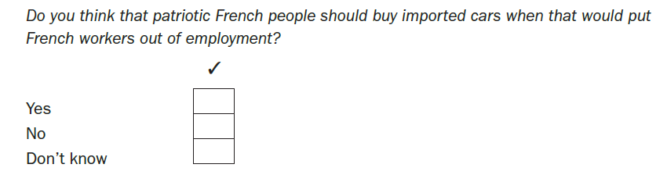
Avoid Leading and Loaded Questions
Leading question: A question that suggests or implies certain answers.
How do you generally spend your free time, watching television or what?
Loaded question: A question that suggests a socially desirable answer or is emotionally charged.
We are happy when you like programs on Channel 7. We are sad when you dislike programs on Channel 7. Write us and let us know what you think of our programming.

Slide 18
Leading and loaded questions are a major source of bias in question wording. A leading question suggests or implies certain answers. A media study on environmental consciousness asked consumers this question:

Slide 19
Certain answers to questions are more socially desirable than others. For example, a truthful answer to the following classification question might be painful:

Slide 20
Avoid Ambiguity: Be as Specific as Possible
Items on questionnaires often are ambiguous because they are too general. Consider such indefinite words as often, occasionally, regularly, frequently, many, good, and poor. Each of these words has many different meanings.
For one consumer frequent reading of Fortune magazine may be reading six or seven issues a year. Another consumer may think reading two issues a year is frequent.
Questions such as the following one, used in a study measuring the reactions of consumers to a television boycott, should be interpreted with care:

Slide 21
Avoid Double-Barreled Items
Double-barreled question: A question covering several issues at once is referred to as a double-barreled question and should always be avoided.
Please indicate how much you agree with the following statement: ‘Labor unions and management are responsible for the auto crisis.’
Do you think Coca-Cola is a tasty and refreshing soft drink?’

Slide 22

Avoid Making Assumptions
This question has a built-in assumption: that people believe the gift-wrapping program is excellent.
By answering “yes,” the respondent implies that the program is, in fact, excellent and that things are fine just as they are.
When a respondent answers “no,” the opinion is to discontinue the program implying that it isn’t excellent. But, perhaps the respondent simply doesn’t think gift wrapping offers any value whether the service is excellent or not.

Slide 23
IN WHAT SEQUENCE SHOULD THE QUESTIONS BE ARRANGED?
The order of questions is of equal importance to the wording used in the questions.
The following issues help to determine the order of questions.
Opening questions
Question categories and structure
Difficult questions
Effect on subsequent questions
Logical order

Slide 24
Opening questions
The opening questions can be crucial in gaining the confidence and cooperation of respondents. These questions should be interesting, simple and non-threatening. Questions that ask respondents for their opinions can be good opening questions, because most people like to express their opinions.
Sometimes such questions are asked although they are unrelated to the research problem and their responses are not analyzed.
Though classification questions seem simple to start a questionnaire, issues like age, gender and income can be seen as sensitive issues. Opening a questionnaire with these questions tends to make respondents concerned about the purpose of these questions and indeed the whole survey.
However, in some instances it is necessary to qualify respondents to determine whether they are eligible to participate in the interview. In this case the qualifying questions serve as the opening questions, and they may have to be classification questions such as the age of the respondent.

Slide 25
Question categories and structure
Questionnaires contain three categories of questions:
Administrative questions (Identification information) Identify the participant, interviewer, interview location, and conditions. A type of information obtained in a questionnaire that includes name, address and phone number.
Classification questions usually cover sociological-demographic variables that allow participants’ answers to be grouped so that patterns are revealed and can be studied. These questions usually appear at the end of a survey.
Target questions address the investigative questions of a specific study. These are grouped by topic in the survey. Target questions may be structured, unstructured , disguised and undisguised

Slide 26
Difficult questions
Difficult questions or questions that are sensitive, embarrassing, complex or dull should be placed late in the sequence.
After rapport has been established and the respondents become involved, they are less likely to object to these questions. Likewise, income should be the last question in the classification section (if it is to be used at all).

Slide 27
Effect on subsequent questions
Questions asked early in a sequence can influence the responses to subsequent questions.
As a rule of thumb, general questions should precede specific questions. This prevents specific questions from biasing responses to the general questions.
Consider the following sequence of questions:
Q1: In selecting a bank, how important is convenience of its location?
Q2: What considerations are important to you in selecting a bank?

Slide 28
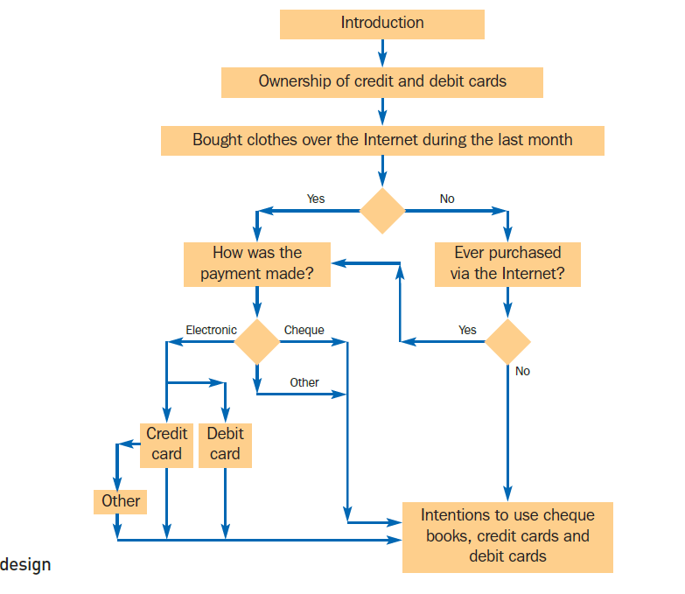
Logical order

Slide 29
Filter question
A question that screens out respondents who are not qualified to answer a second question. Asking a question that does not apply to the respondent or that the respondent is not qualified to answer may be irritating or cause a biased response because the respondent wishes to please the interviewer or to avoid embarrassment.

Slide 30
WHAT QUESTIONNAIRE LAYOUT WILL BEST SERVE THE RESEARCH OBJECTIVES?
The format, spacing and positioning of questions can have a significant effect on the results, particularly in self-administered questionnaires.
It is good practice to divide a questionnaire into several parts.
The questions in each part should be numbered, particularly when branching questions are used. Numbering of questions also makes the coding of responses easier. In addition, the questionnaires should preferably be pre-coded.

Slide 31
PRETESTING AND REVISING QUESTIONNAIRES
Usually the questionnaire is tried out on a group, selected on a convenience basis, that is similar in makeup to the one that ultimately will be sampled.
PRELIMINARY TABULATION
Tabulating the results of a pretest helps determine whether the questionnaire will meet the objectives of the research.
A preliminary tabulation often illustrates that the question is inappropriate because it does not provide relevant information to help solve the problem at hand .

Slide 32
THANK YOU

Slide 33
 | Disguised | Non-disguised
Structured | Which of the following eat a lot, and which a little oatmeal: Farmers, Movies actors etc. Some attitude measurements | Does your family own piano?
Non-structured | Some projective techniques | Ask respondent(s) to discuss what they think when canned soup is mentioned (Focus groups and depth interviewers)

